Slide 1
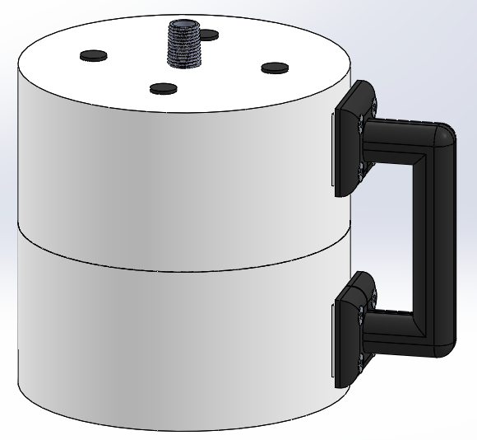
Handle allows user to easily carry the device around

Slide 2
Threaded tube to allow device to be fastened to the tap
Handle allows user to easily carry the device around

Slide 3
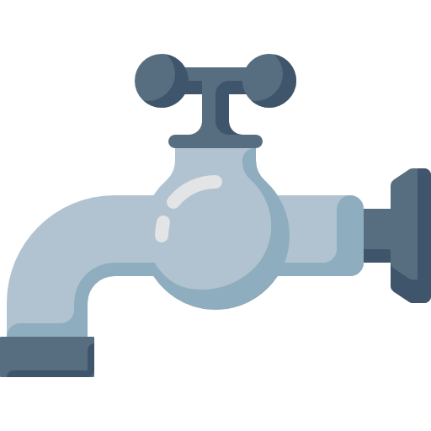
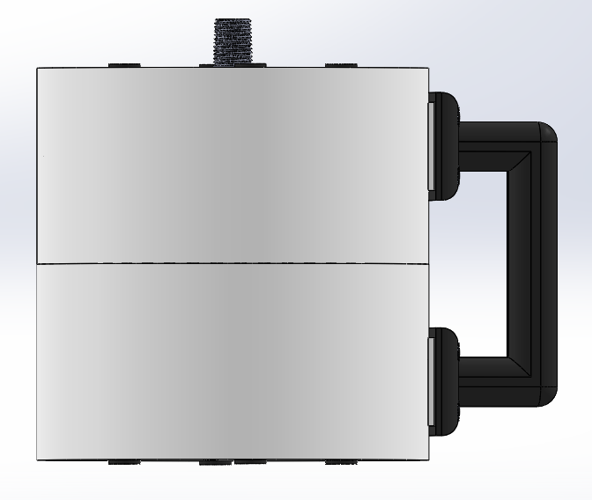

Slide 7
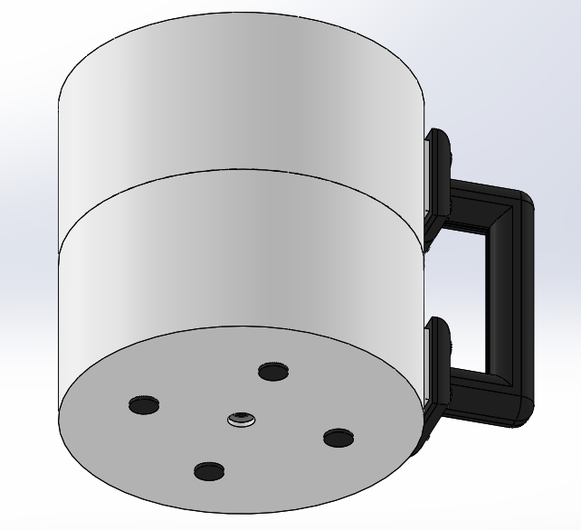

Slide 8
